Slide 1
Mine Sweeper
[RL] 24.02 ~ .

Slide 2
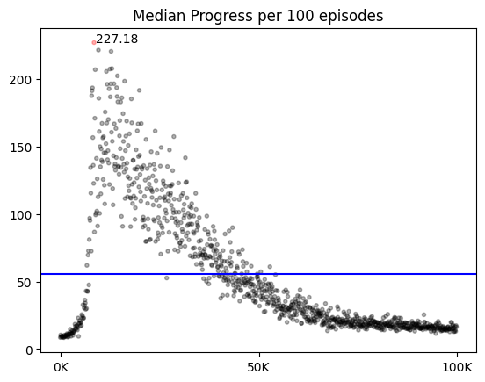
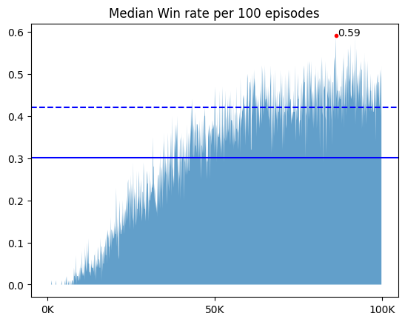
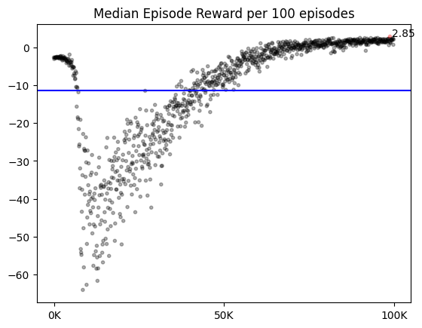
😀😎🥵 | SavedTitle
Agent Type | Vector Type, Scalar Type
Training Step | every timesteps, every episodes
신경망 | Conv 4층 (3x3, 1st padding 2, ~. Padding 1)
Net Setting | CONV_UNITS = 64 UPDATE_TARGET_EVERY = 5
state | Single layer, shape=map_size -2 : Mine, -1 : Unrevealed, 0~8 : # of neighbor Mines Normalization : by 8(max #)
replay memory | 18개 이하는 저장 안함 50000 / 1000
Learning Params | BATCH_SIZE = 64 LEARNING_RATE = 0.001 LEARN_DECAY = 0.99999975 LEARN_MIN = 0.001 DISCOUNT = 0.1
Scheduler
Exploration Params | EPSILON = 0.95 EPSILON_DECAY = 0.99975 EPSILON_MIN = 0.01
Reward & Done | {'win':1, 'lose':-1, 'progress':0.3, 'guess':-0.3, ‘no_progress’:-0.3} {'win':True, 'lose':True, 'progress':False, 'guess':False, 'no_progress' : True})
Episodes | 20만
Train / Valid Intervals | PRINT_INTERVAL = 100 VISUAL_INTERVAL = 100 VALID_SAMPLE = 1000 VALID_INTERVAL = 10
최고 성능 | Train : 0.79 | valid : 0.625 | success : 0.604
Imported Libraries and version
from codes.environment.reward5 import *
from codes.agent.newVectorDQN import *
from codes.net.basicWithBias import *
from codes.trainer.validShutDown import *
from codes.tester.validShutDown import *
 | Fixed1000 | Random1000
Best_Valid | 15.00 | 4.00 | 0.572 | 15.00 | 4.00 | 0.572
Best_Train
Win_Model
Latest_Model

Slide 3
😀 : Not bad, normal
😎 : Break Through
🥵 : Problem Occurs

Slide 4
😀 | Baseline_scalar
Agent Type | Vector Type, Scalar Type
Training Step | every timesteps, every episodes
신경망 | Conv 4층 (3x3, 1st padding 2, ~. Padding 1)
Net Setting | CONV_UNITS = 64 UPDATE_TARGET_EVERY = 5
state | Single layer, shape=map_size -2 : Mine, -1 : Unrevealed, 0~8 : # of neighbor Mines Normalization : by 8(max #)
replay memory | 18개 이하는 저장 안함 50000 / 1000
Learning Params | BATCH_SIZE = 64 LEARNING_RATE = 0.001 DISCOUNT = 0.1
Scheduler | X
Exploration Params | EPSILON = 0.95 EPSILON_DECAY = 0.999975 EPSILON_MIN = 0.01
Reward & Done | {'win':1, 'lose':-1, 'progress':0.3, 'guess':-0.3, ‘no_progress’:-0.3} {'win':True, 'lose':True, 'progress':False, 'guess':False, 'no_progress＇ : False})
Episodes | 10만
Train / Valid Intervals | PRINT_INTERVAL = 100 VISUAL_INTERVAL = 100 VALID_SAMPLE = 1000 VALID_INTERVAL = 10
최고 성능 | Train : 0.59 | valid : 0.309 | success : 0.316
Imported Libraries and version
from codes.environment.reward5 import *
from codes.agent.scalarDQN import *
from codes.net.basicWithBias import *
from codes.trainer.validShutDown import *
from codes.tester.validShutDown import *
 | Fixed1000 | Random1000
Best_Valid
Best_Train
Win_Model
Latest_Model
특징 : 초반에 vector type보다 같은 곳을 또 누르는 경우가 훨씬 많아 step 수가 증가한다. 따라서 학습시간도 길다.

Slide 5
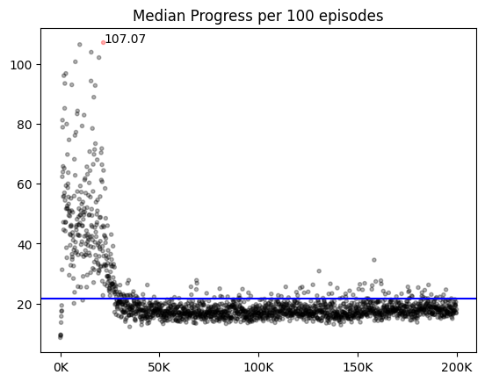
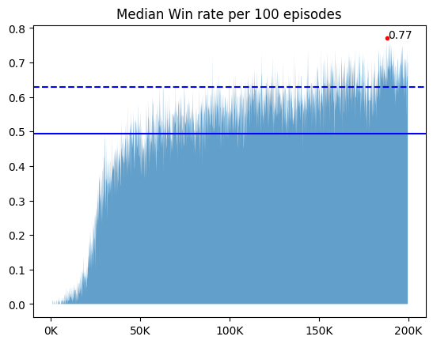
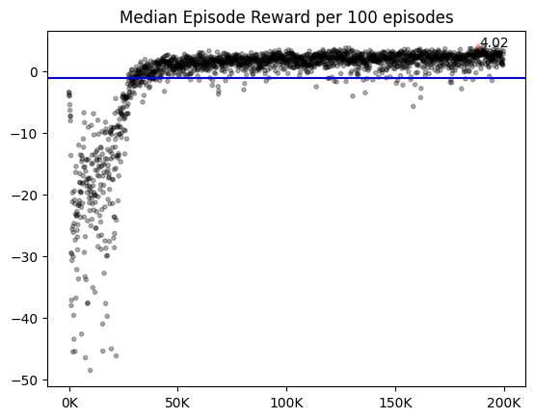
😀 | Baseline_vector
Agent Type | Vector Type, Scalar Type
Training Step | every timesteps, every episodes
신경망 | Conv 4층 (3x3, 1st padding 2, ~. Padding 1)
Net Setting | CONV_UNITS = 64 UPDATE_TARGET_EVERY = 5
state | Single layer, shape=map_size -2 : Mine, -1 : Unrevealed, 0~8 : # of neighbor Mines Normalization : by 8(max #)
replay memory | 18개 이하는 저장 안함 50000 / 1000
Learning Params | BATCH_SIZE = 64 LEARNING_RATE = 0.001 DISCOUNT = 0.1
Scheduler | X
Exploration Params | EPSILON = 0.95 EPSILON_DECAY = 0.99975 EPSILON_MIN = 0.01
Reward & Done | {'win':1, 'lose':-1, 'progress':0.3, 'guess':-0.3, ‘no_progress’:-0.5} {'win':True, 'lose':True, 'progress':False, 'guess':False, 'no_progress’ : False})
Episodes | 20만
Train / Valid Intervals | PRINT_INTERVAL = 100 VISUAL_INTERVAL = 100 VALID_SAMPLE = 1000 VALID_INTERVAL = 10
최고 성능 | Train : 0.77 | valid : 0.662 | success : 0.663
Imported Libraries and version
from codes.environment.reward5 import *
from codes.agent.vectorDQN import *
from codes.net.basicWithBias import *
from codes.trainer.validShutDown import *
from codes.tester.validShutDown import *
 | Fixed1000 | Random1000
Best_Valid
Best_Train
Win_Model
Latest_Model
For문 사용하는 기존 버전이다.

Slide 6
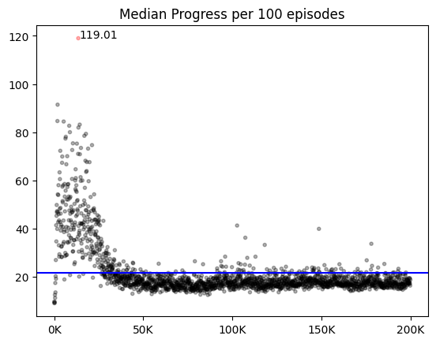
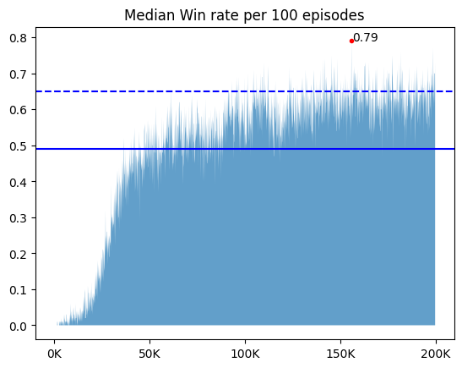
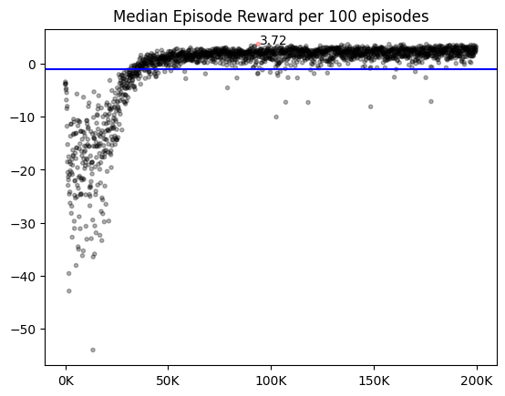
😀 | Baseline_vector
Agent Type | Vector Type, Scalar Type
Training Step | every timesteps, every episodes
신경망 | Conv 4층 (3x3, 1st padding 2, ~. Padding 1)
Net Setting | CONV_UNITS = 64 UPDATE_TARGET_EVERY = 5
state | Single layer, shape=map_size -2 : Mine, -1 : Unrevealed, 0~8 : # of neighbor Mines Normalization : by 8(max #)
replay memory | 18개 이하는 저장 안함 50000 / 1000
Learning Params | BATCH_SIZE = 64 LEARNING_RATE = 0.001 DISCOUNT = 0.1
Scheduler | X
Exploration Params | EPSILON = 0.95 EPSILON_DECAY = 0.99975 EPSILON_MIN = 0.01
Reward & Done | {'win':1, 'lose':-1, 'progress':0.3, 'guess':-0.3, ‘no_progress’:-0.5} {'win':True, 'lose':True, 'progress':False, 'guess':False, 'no_progress’ : False})
Episodes | 20만
Train / Valid Intervals | PRINT_INTERVAL = 100 VISUAL_INTERVAL = 100 VALID_SAMPLE = 1000 VALID_INTERVAL = 10
최고 성능 | Train : 0.79 | valid : 0.625 | success : 0.604
Imported Libraries and version
from codes.environment.reward5 import *
from codes.agent.newVectorDQN import *
from codes.net.basicWithBias import *
from codes.trainer.validShutDown import *
from codes.tester.validShutDown import *
 | Fixed1000 | Random1000
Best_Valid
Best_Train
Win_Model
Latest_Model
수정한 버전도 제대로 학습이 되며 비슷한 양상을 보이기 때문에 일단 대체 가능하다 볼 수 있을 것 같다. 여전히 no_progress를 누르는 문제는 해결되지 않았다.

Slide 7
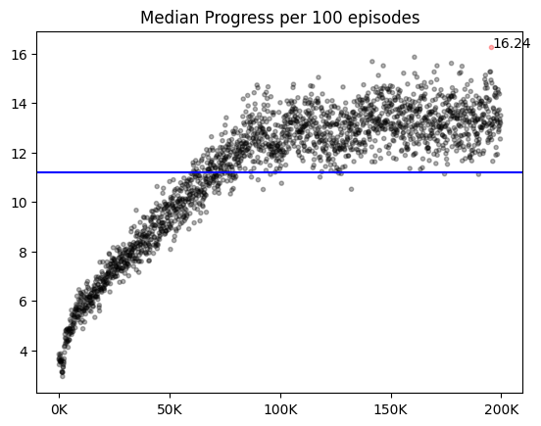
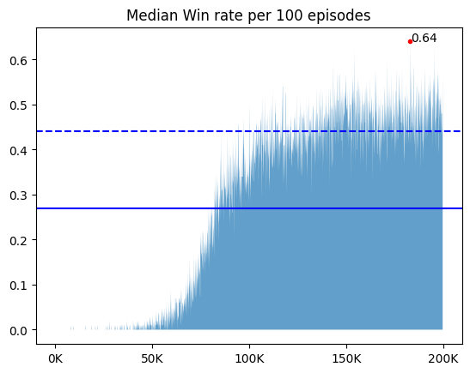
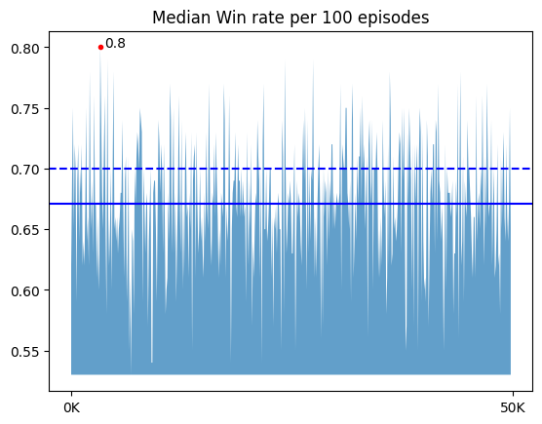
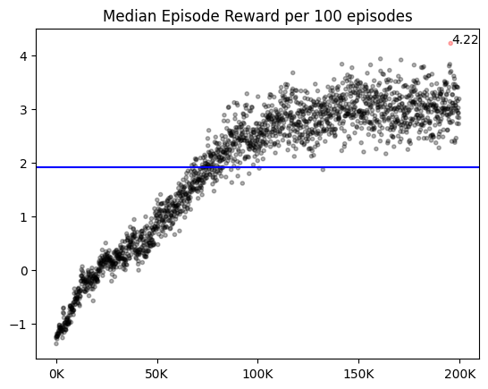
😎 | vector_no_progress_shutdown
Agent Type | Vector Type, Scalar Type
Training Step | every timesteps, every episodes
신경망 | Conv 4층 (3x3, 1st padding 2, ~. Padding 1)
Net Setting | CONV_UNITS = 64 UPDATE_TARGET_EVERY = 5
state | Single layer, shape=map_size -2 : Mine, -1 : Unrevealed, 0~8 : # of neighbor Mines Normalization : by 8(max #)
replay memory | 18개 이하는 저장 안함 50000 / 1000
Learning Params | BATCH_SIZE = 64 LEARNING_RATE = 0.001 LEARN_DECAY = … 이유가 있다. LEARN_MIN = 0.000025 DISCOUNT = 0.1
Scheduler | X
Exploration Params | EPSILON = 0.95 EPSILON_DECAY = 0.99975 EPSILON_MIN = 0.01
Reward & Done | {'win':1, 'lose':-1, 'progress':0.3, 'guess':-0.3, ‘no_progress’:-0.5} {'win':True, 'lose':True, 'progress':False, 'guess':False, 'no_progress' : True})
Episodes | 5만, 10만, 15만, 20만
Train / Valid Intervals | PRINT_INTERVAL = 100 VISUAL_INTERVAL = 100 VALID_SAMPLE = 1000 VALID_INTERVAL = 10
최고 성능 | Train : 0.87 | valid : 0.806 | success : 0.787
Imported Libraries and version
from codes.environment.reward5 import *
from codes.agent.newVectorDQN import *
from codes.net.basicWithBias import *
from codes.trainer.validShutDown import *
from codes.tester.validShutDown import *
 | Fixed1000 | Random1000
Best_Valid |  | 16.00 | 4.90 | 0.744
Best_Train |  | 17.00 | 4.90 | 0.764
Win_Model |  | 17.00 | 4.90 | 0.787
Latest_Model |  | 17.00 | 4.90 | 0.766
중간에 학습이 날라가서 60만까지 돌렸지만 연속된 학습 그래프가 없다..
이미 열린 곳 만을 계속 눌러서 에피소드가 끝나지 않는 문제를 해결하고자, 이미 열린 타일을 열었을 때 lose 절반의 보상을 주며 에피소드를 강제 종료했다.
이 스크립트에서 학습 향상이 일어났으며, 두 가지가 변경되었다.
같은데 또 눌렀을 때 에피소드 종료 : 종료하지 않았을 때에 비해 초반 수렴이 느리다.
lr 조정 : 지금까지 lr를 줄이며 학습했다 생각했는데 아니었다. 20만 step마다 0.001 -> 0.0001 -> 0.000025으로 직접 하이퍼 파라미터를 조정해줬다.. 이때 0.0001에서는 의미있는 학습 성장률이 있었으나, 더 작을 때는 그냥 비슷했다.

Slide 8
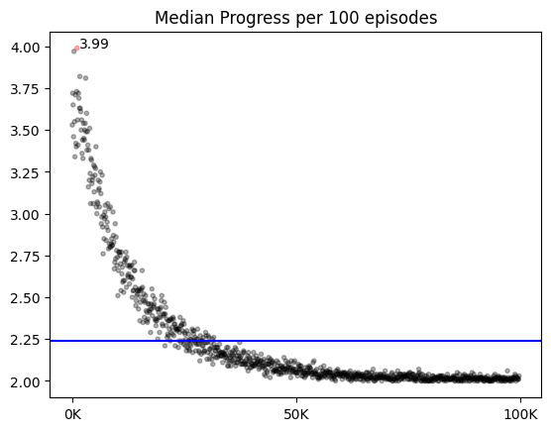
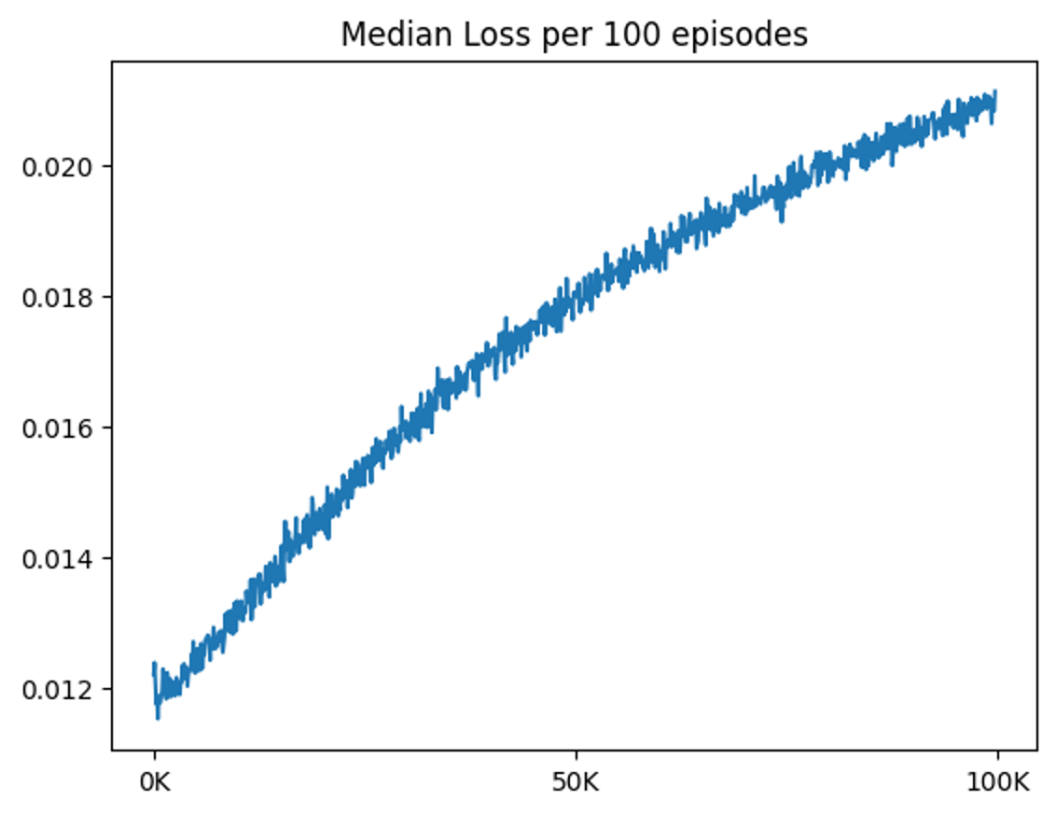
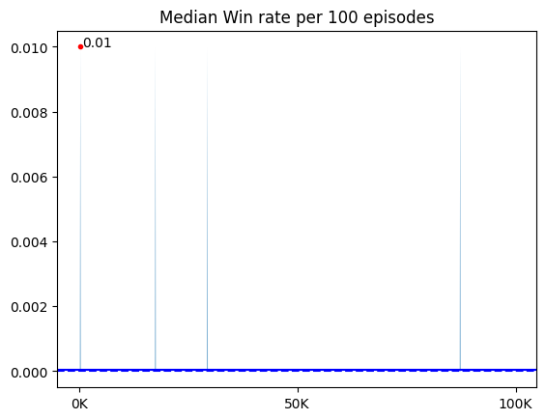
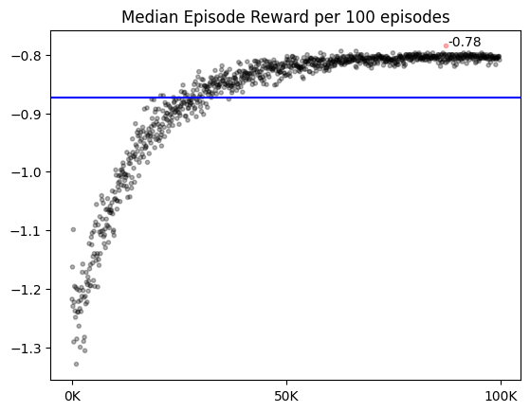
🥵 | vector_resnet
Agent Type | Vector Type, Scalar Type
Training Step | every timesteps, every episodes
신경망 | Conv 4층 (3x3, 1st padding 2, ~. Padding 1)
Net Setting | CONV_UNITS = 64 UPDATE_TARGET_EVERY = 5
state | Single layer, shape=map_size -2 : Mine, -1 : Unrevealed, 0~8 : # of neighbor Mines Normalization : by 8(max #)
replay memory | 18개 이하는 저장 안함 50000 / 1000
Learning Params | BATCH_SIZE = 64 LEARNING_RATE = 0.001 DISCOUNT = 0.1
Scheduler | X
Exploration Params | EPSILON = 0.95 EPSILON_DECAY = 0.99975 EPSILON_MIN = 0.01
Reward & Done | {'win':1, 'lose':-1, 'progress':0.3, 'guess':-0.3, ‘no_progress’:-0.5} {'win':True, 'lose':True, 'progress':False, 'guess':False, 'no_progress' : True})
Episodes | 10만
Train / Valid Intervals | PRINT_INTERVAL = 100 VISUAL_INTERVAL = 100 VALID_SAMPLE = 1000 VALID_INTERVAL = 10
최고 성능 | Train : 0.01 | valid : 0.00 | success : 0.00
Imported Libraries and version
from codes.environment.reward5 import *
from codes.agent.newVectorDQN import *
from codes.net.resNet import *
from codes.trainer.validShutDown import *
from codes.tester.validShutDown import *
 | Fixed1000 | Random1000
Best_Valid
Best_Train
Win_Model
Latest_Model
Reward는 증가하는데 loss가 증가하는건 대체 뭘까 애초에 progress가 떨어지는데 리워드가 증가하는 것도 웃긴다. 어차피 – 에서 -라서 의미는 없지만 말이다. 신경망을 뜯어 고쳐야 할 것 같다.

Slide 9
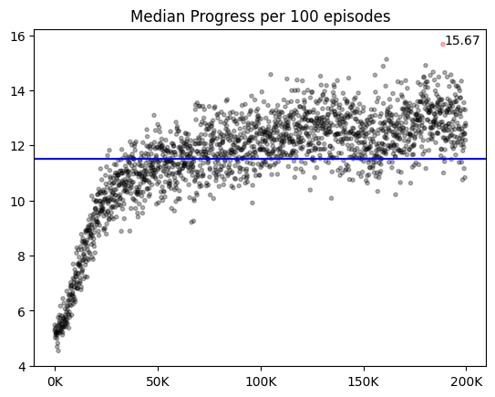
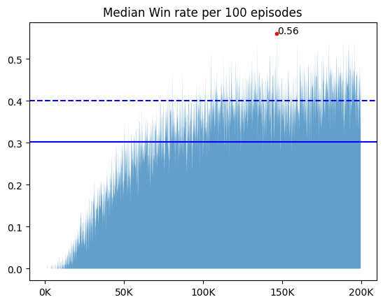
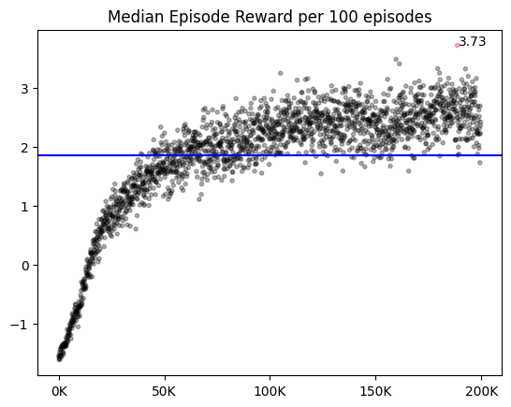
😀 | scalar_reveal_aware
Agent Type | Vector Type, Scalar Type
Training Step | every timesteps, every episodes
신경망 | Conv 4층 (3x3, 1st padding 2, ~. Padding 1)
Net Setting | CONV_UNITS = 64 UPDATE_TARGET_EVERY = 5
state | Single layer, shape=map_size -2 : Mine, -1 : Unrevealed, 0~8 : # of neighbor Mines Normalization : by 8(max #)
replay memory | 18개 이하는 저장 안함 50000 / 1000
Learning Params | BATCH_SIZE = 64 LEARNING_RATE = 0.001 DISCOUNT = 0.1
Scheduler | X
Exploration Params | EPSILON = 0.95 EPSILON_DECAY = 0.99975 EPSILON_MIN = 0.01
Reward & Done | {'win':1, 'lose':-1, 'progress':0.3, 'guess':-0.3, ‘no_progress’:-0.3} {'win':True, 'lose':True, 'progress':False, 'guess':False, 'no_progress’ : False})
Episodes | 20만
Train / Valid Intervals | PRINT_INTERVAL = 100 VISUAL_INTERVAL = 100 VALID_SAMPLE = 1000 VALID_INTERVAL = 10
최고 성능 | Train : 0.56 | valid : 0.467 | success : 0.447
Imported Libraries and version
from codes.environment.reward5 import *
from codes.agent.scalarDQNRevealAware import *
from codes.net.basicWithBias import *
from codes.trainer.validShutDown import *
from codes.tester.validShutDown import *
 | Fixed1000 | Random1000
Best_Valid
Best_Train
Win_Model
Latest_Model
Scalar에서도 vector 때와 유사한 양상이 보였다.

Slide 10
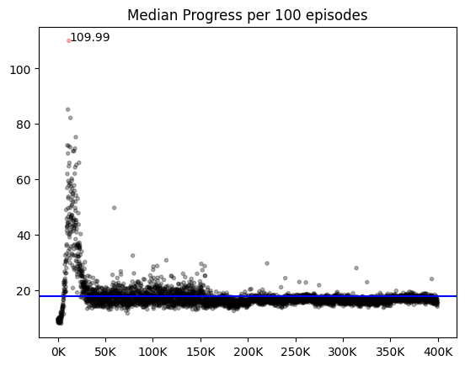
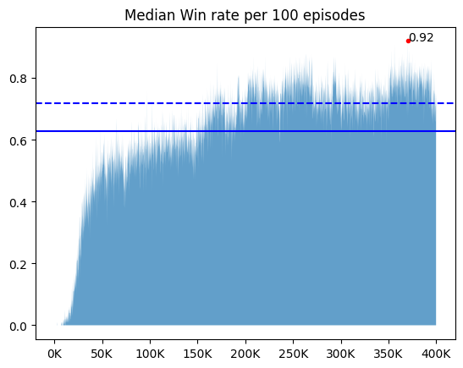
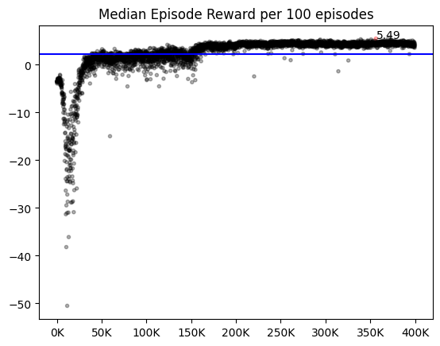
😎 | vector_sch
Agent Type | Vector Type, Scalar Type
Training Step | every timesteps, every episodes
신경망 | Conv 4층 (3x3, 1st padding 2, ~. Padding 1)
Net Setting | CONV_UNITS = 64 UPDATE_TARGET_EVERY = 5
state | Single layer, shape=map_size -2 : Mine, -1 : Unrevealed, 0~8 : # of neighbor Mines Normalization : by 8(max #)
replay memory | 18개 이하는 저장 안함 50000 / 1000
Learning Params | BATCH_SIZE = 64 LEARNING_RATE = 0.001 LEARN_DECAY = 0.25 LEARN_EPOCH = 50_000 DISCOUNT = 0.1
Scheduler | optim.lr_scheduler.StepLR
Exploration Params | EPSILON = 0.95 EPSILON_DECAY = 0.999975 EPSILON_MIN = 0.01
Reward & Done | {'win':1, 'lose':-1, 'progress':0.3, 'guess':-0.3, ‘no_progress’:-0.3} {'win':True, 'lose':True, 'progress':False, 'guess':False, 'no_progress＇ : False})
Episodes | 20만, 40만
Train / Valid Intervals | PRINT_INTERVAL = 100 VISUAL_INTERVAL = 100 VALID_SAMPLE = 1000 VALID_INTERVAL = 10
최고 성능 | train : 0.92 | valid : 0.829 | success : 0.825
Imported Libraries and version
from codes.environment.reward5 import *
from codes.agent.newVectorDQN import *
from codes.net.basicWithBias import *
from codes.trainer.validShutDown import *
from codes.tester.validShutDown import *
 | Fixed1000 | Random1000
Best_Valid |  | 17.00 | 5.20 | 0.738
Best_Train |  | 17.00 | 4.90 | 0.755
Win_Model |  | 17.00 | 5.20 | 0.723
Latest_Model |  | 17.00 | 4.90 | 0.745
Train 중 도달하는 최고점은 더 높지만, test에서는 done=True보다 더 낮은 win rate를 갖는다. (5 %p 내외 ) train과 valid 사이의 괴리는 이미 열린 타일을 또 누르는 상황 때문에 발생한다.

Slide 11
